Slide 1
Daily slides of an eardrum healing itself
Each picture was taken by myself using an inexpensive
otoscope purchased on Amazon on April 21st 2020.
Patient : Skip Meisch from Port Angeles Washington

Slide 2
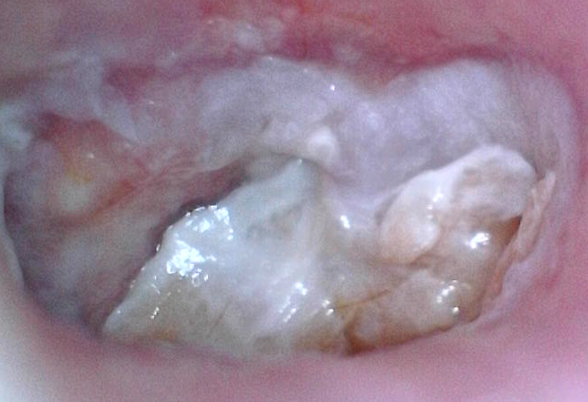
April 24th
After 10 days of eardrops
to stop an infection and
drainage.
My hearing range had
been 40-90 db.
Today I couldn’t hear
anything in this ear and a
later test showed a
range of 85-110 db

Slide 3
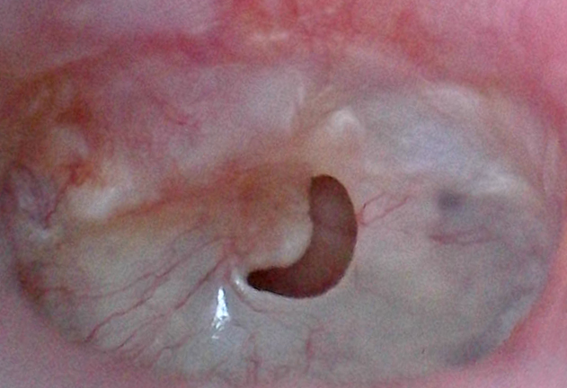
April 30th
2 hours after the ear was
cleaned at an ENT clinic
revealing a hole in the
eardrum.
My GP later said he did not see this
hole when he checked my ears on
April 6th. That was just before his
nurse irrigated the ear. The nurse
didn’t look into the ear after
irrigating it.

Slide 4
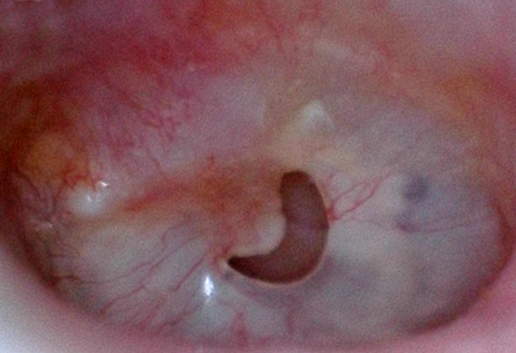
May 1st
The next day. A slight
improvement can be
seen at the lower left
end of the hole.

Slide 5
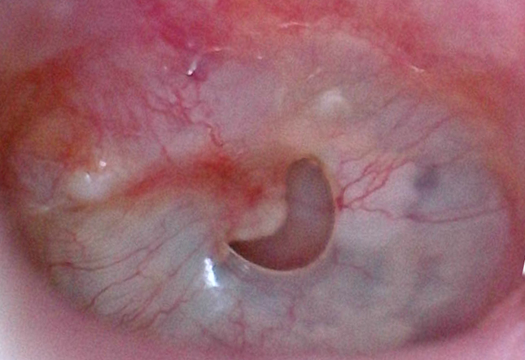
May 2nd
More change at the
Lower left of the hole.
Plus some changing
at the top of the hole.

Slide 6
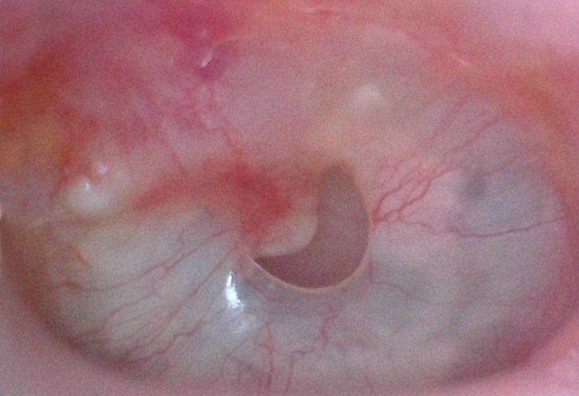
May 3rd
The left and right sides
of the upper area are
beginning to close in.
The lower left has come
to a sharp point as it
begins to close in.

Slide 7
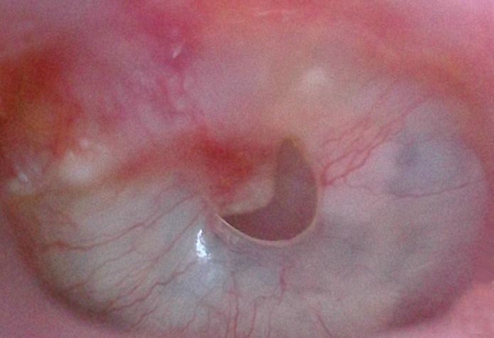
May 4th
Healing continues on a
daily basis.

Slide 8
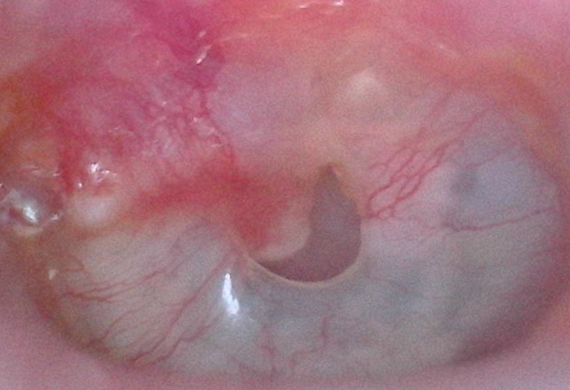
May 6th
Healing continues on a
daily basis.

Slide 9
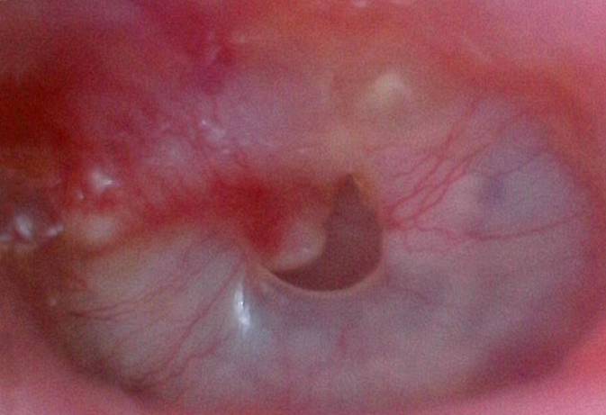
May 7th
Healing continues on a
daily basis.

Slide 10
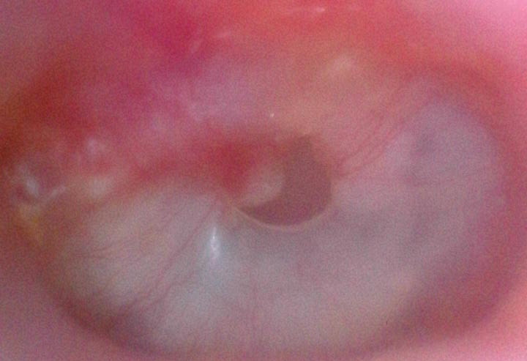
May 8th
Healing continues on a
daily basis.

Slide 11
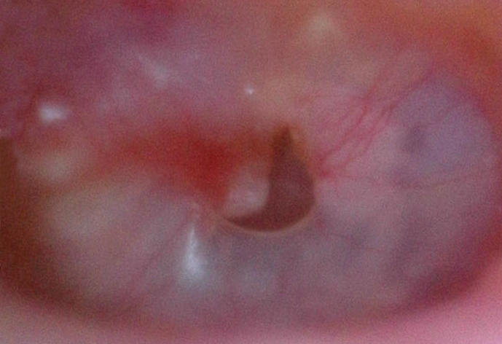
May 9th
Healing continues on a
daily basis.

Slide 12
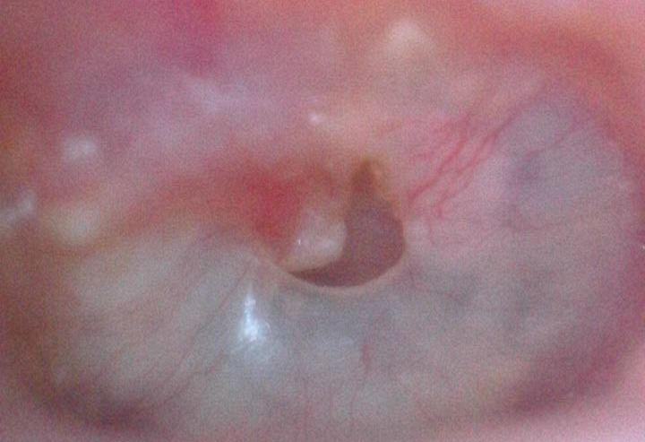
May 10th
Healing continues on a
daily basis.

Slide 13
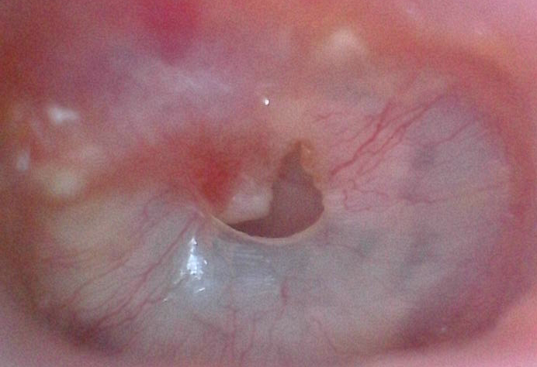
May 11th
Healing continues on a
daily basis.

Slide 14
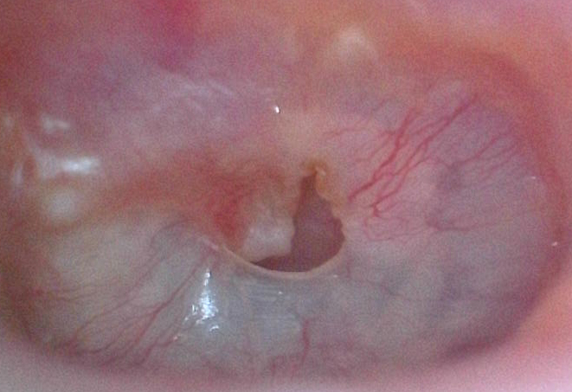
May 12th
Healing continues on a
daily basis.

Slide 15
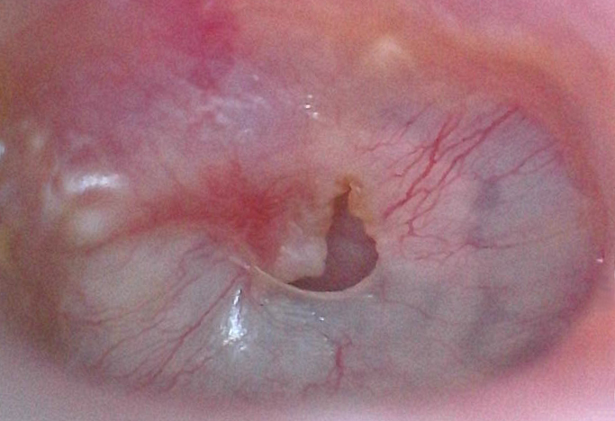
May 13th
Healing continues on a
daily basis.

Slide 16
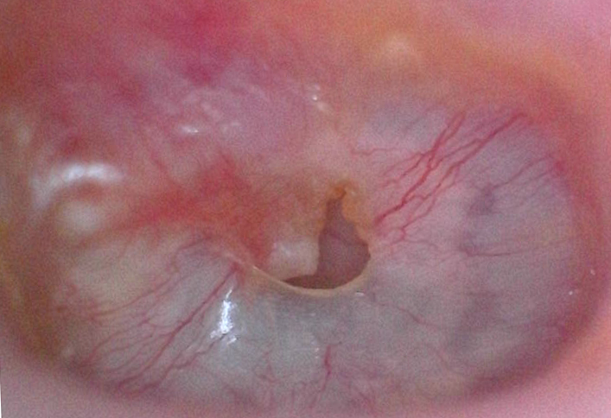
May 14th
Healing continues on a
daily basis.

Slide 17
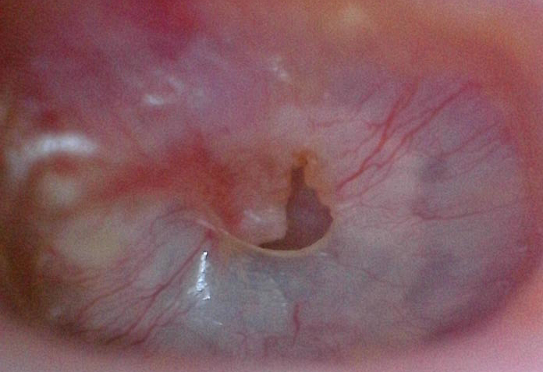
May 15th
Healing continues on a
daily basis.

Slide 18
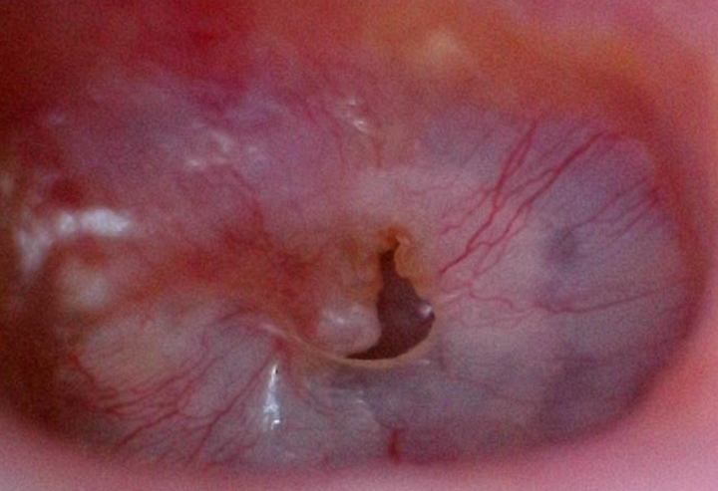
May 16th
Healing continues on a
daily basis.

Slide 19
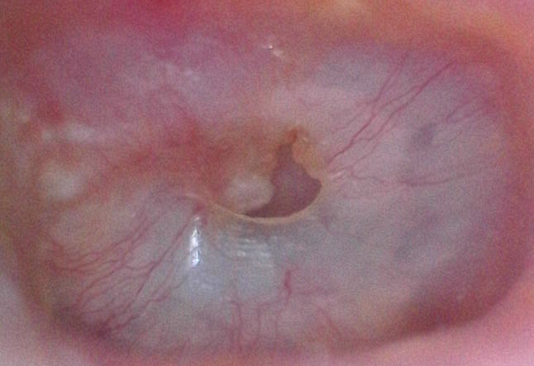
May 17th
Healing continues on a
daily basis.

Slide 20
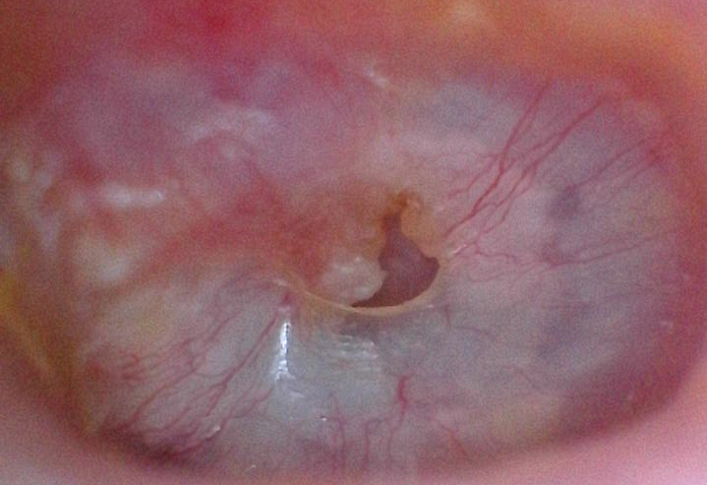
May 18th
Healing continues on a
daily basis.

Slide 21
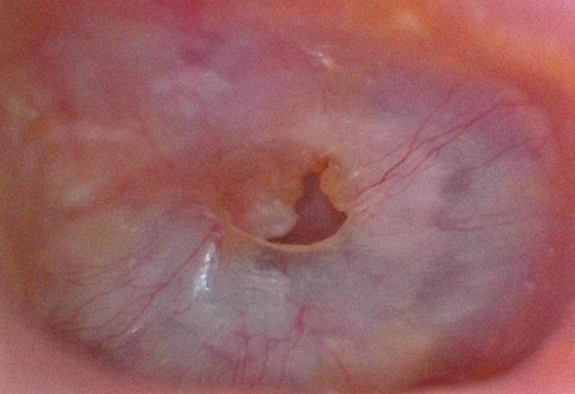
May 19th
Healing continues on a
daily basis.

Slide 22
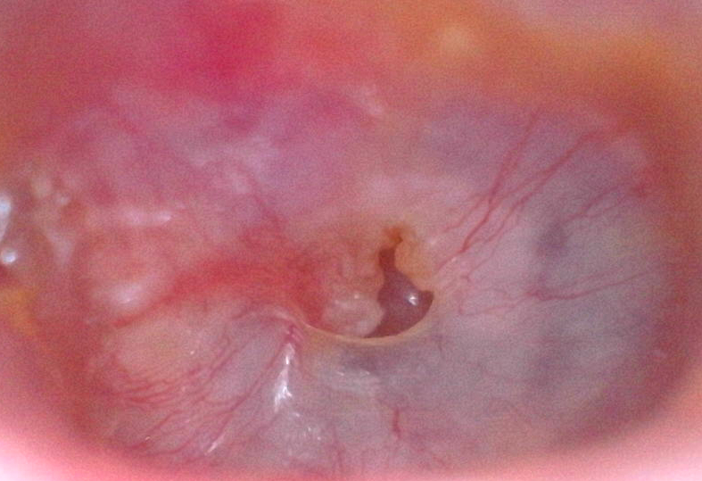
May 20th
Healing continues on a
daily basis.

Slide 23
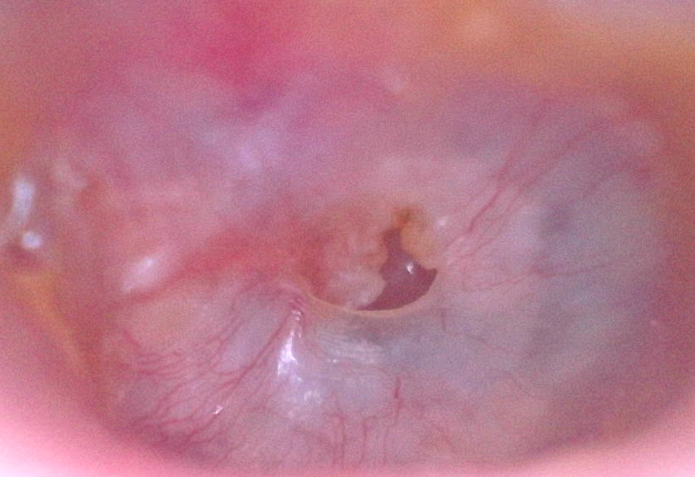
May 21st
Healing continues on a
daily basis.

Slide 24
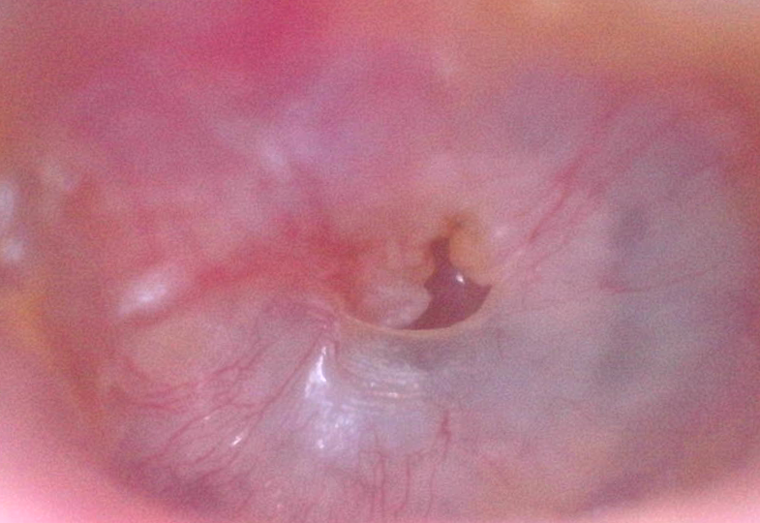
May 22nd
Healing continues on a
daily basis.

Slide 25
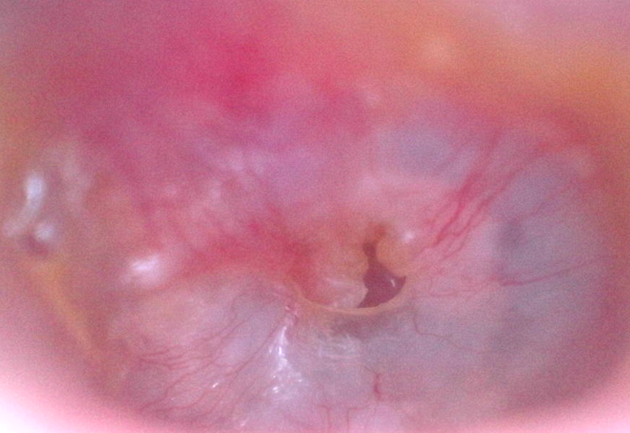
May 23rd
Healing continues on a
daily basis.
Had an MRI today to
check for infection.

Slide 26
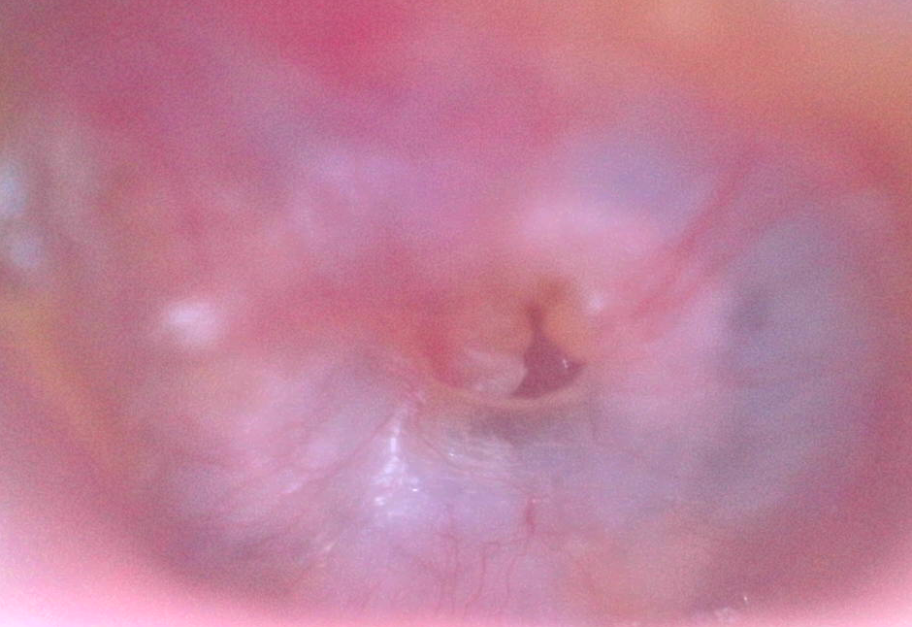
May 24th
Healing continues on a
daily basis.

Slide 27
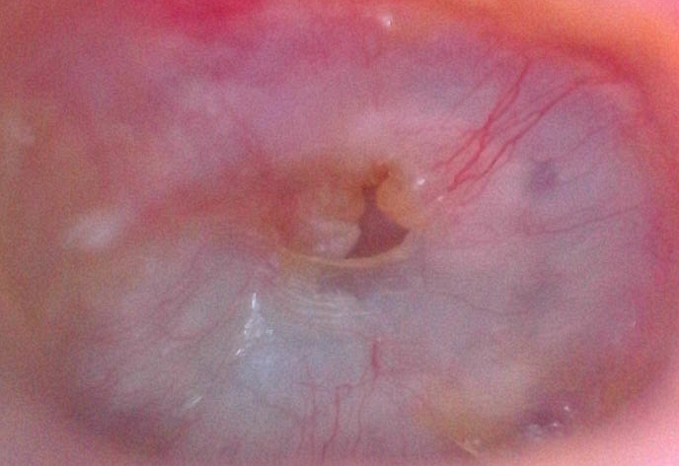
May 25th
Healing continues on a
daily basis.

Slide 28
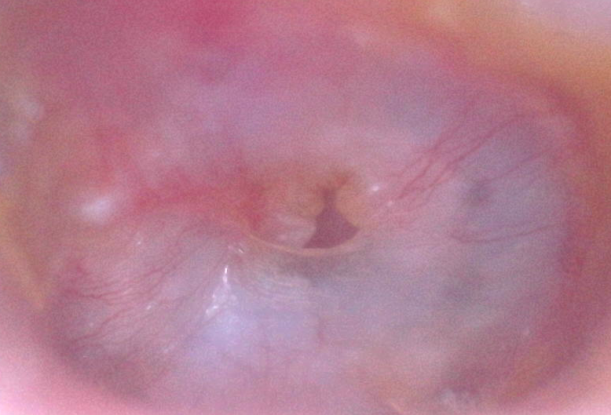
May 26th
Healing continues on a
daily basis.

Slide 29
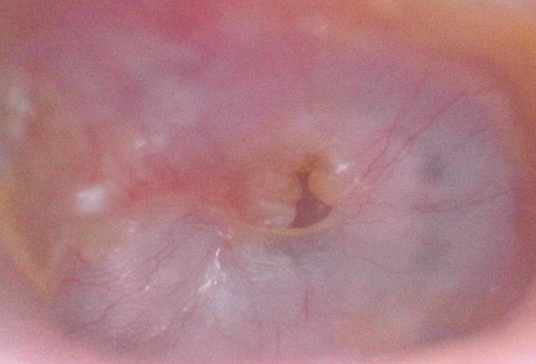
May 27th
Healing continues on a
daily basis.
Began 3 week dose of
antibiotic for possible
infection.

Slide 30
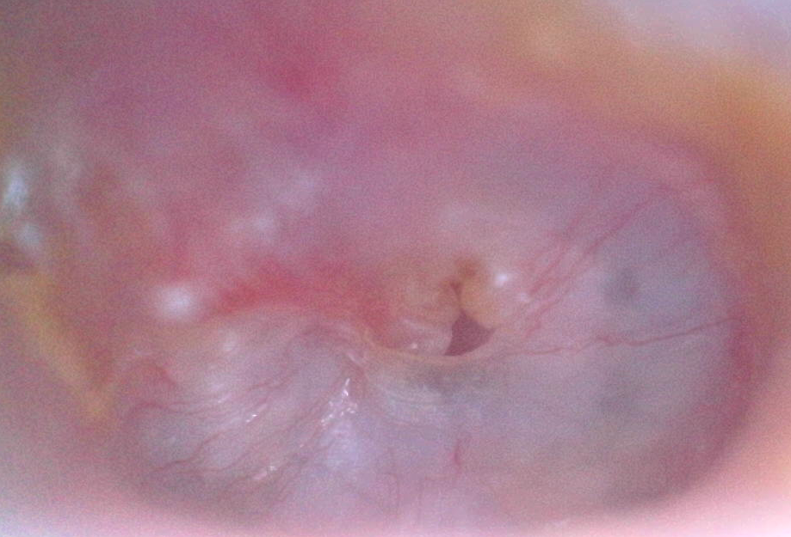
May 28th
Healing continues on a
daily basis.

Slide 31
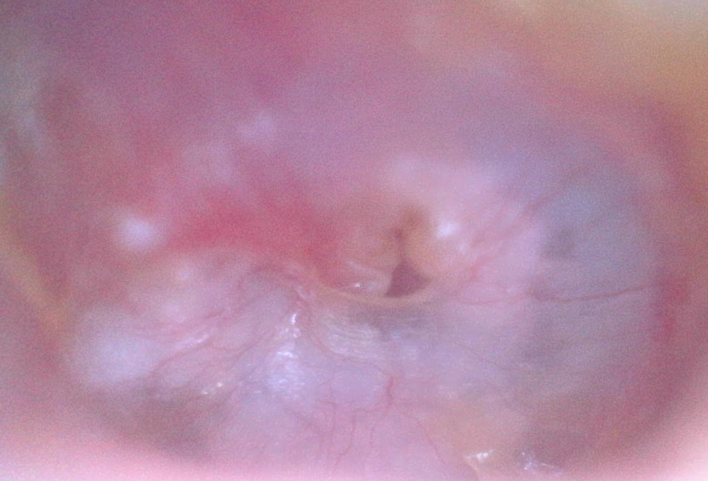
May 29th
Healing continues on a
daily basis.

Slide 32
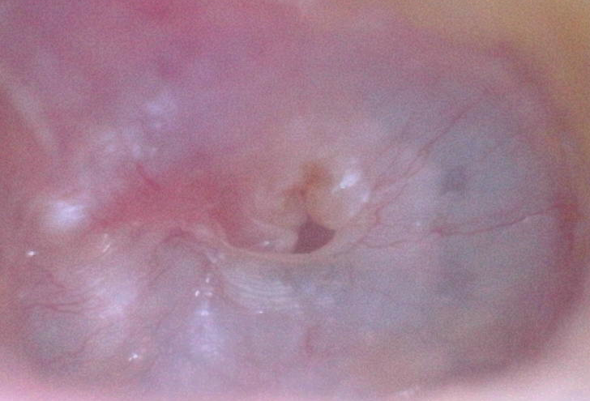
May 30th
Healing continues on a
daily basis.
Today some hearing has
returned but it’s just
noise with no clarity.

Slide 33
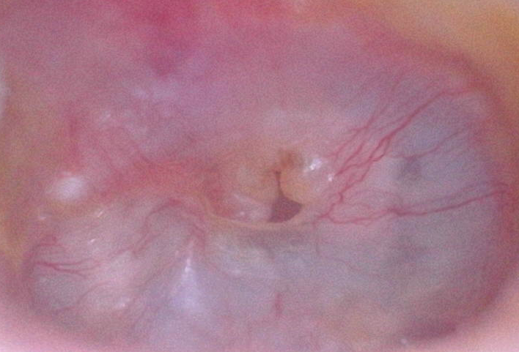
May 31st
At this point it seemed
like the healing was
slowing down and
maybe even stopped.
I thought it might take a
couple more weeks to
fully close.

Slide 34
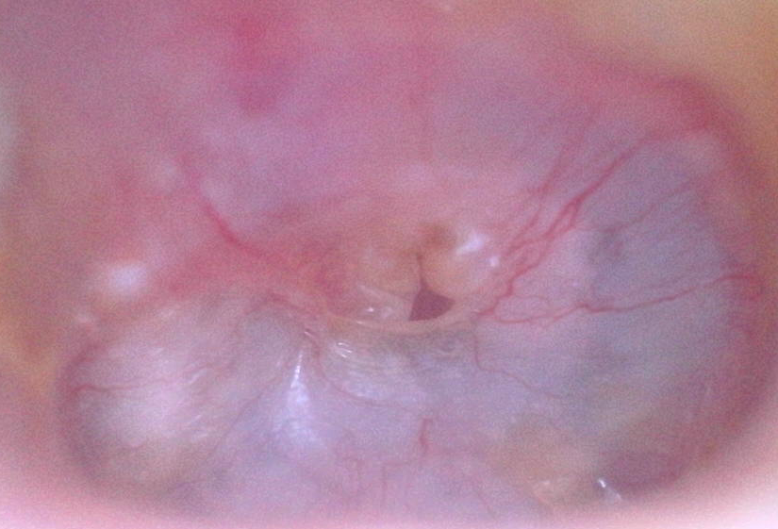
June 1st
Healing has slowed.

Slide 35
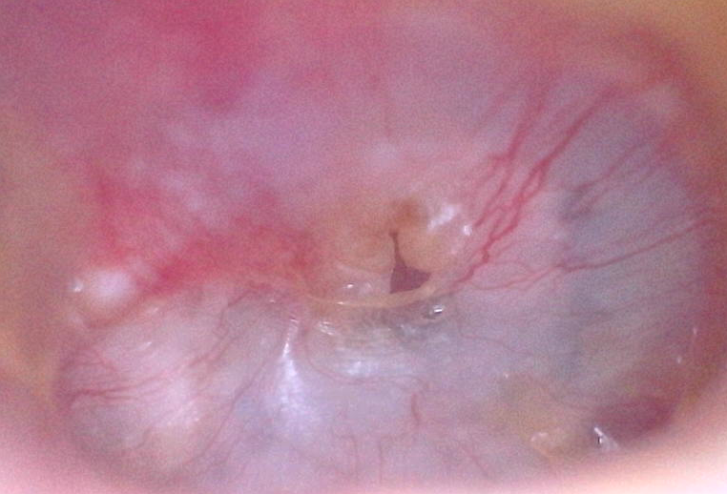
June 2nd
Healing has slowed.

Slide 36
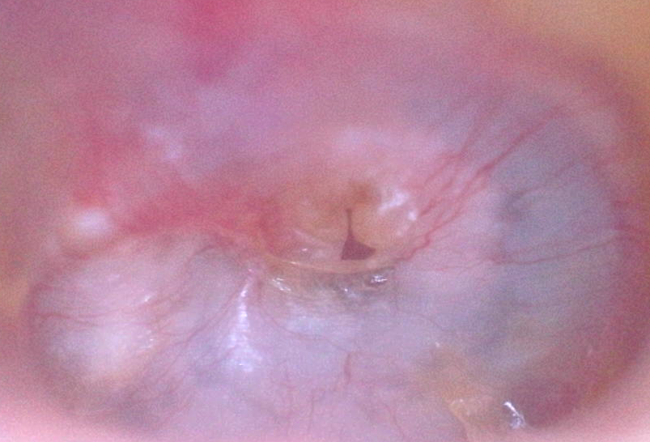
June 3rd
Healing has slowed.

Slide 37
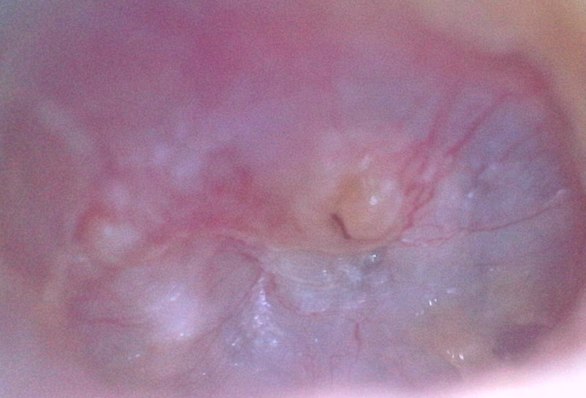
June 4th 10:00 am
Normally I was taking
the pictures in the mid
afternoon. But today I
was anxious to see if
there was any change.
It’s actually almost
closed.

Slide 38
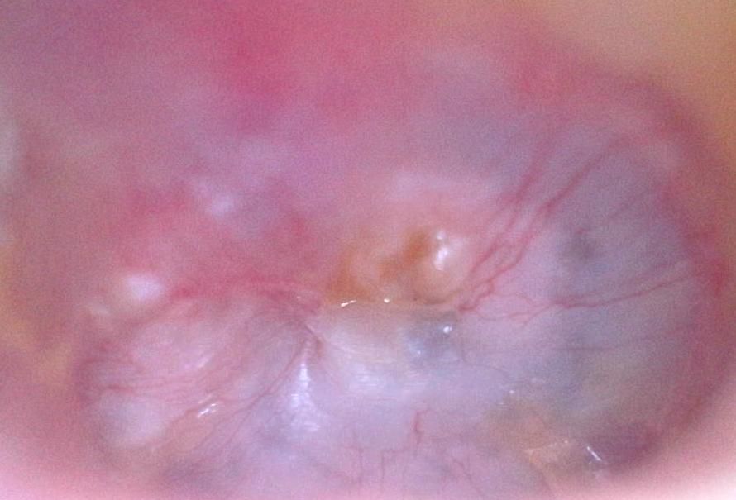
June 4th 5:00 pm
And later that day:
The hole was gone.
But my hearing has not
continued to improve!

Slide 39
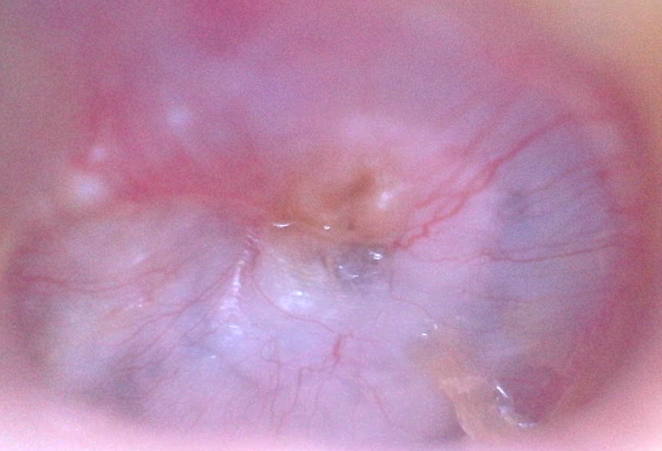
June 5th
One day later and it’s
still closed.

Slide 40
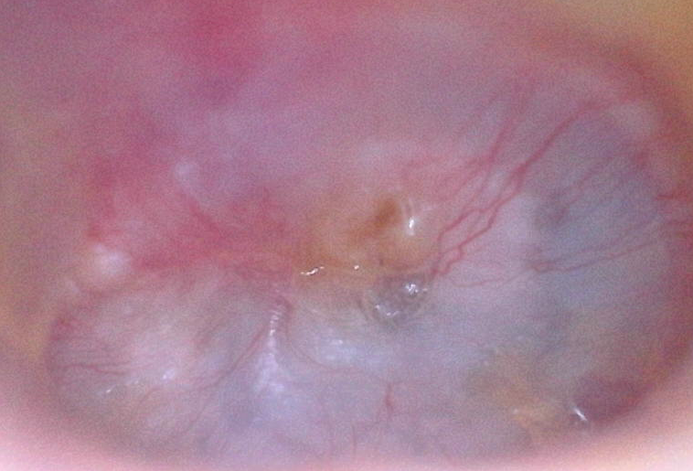
June 6th
2 days later and it’s
still closed.

Slide 41
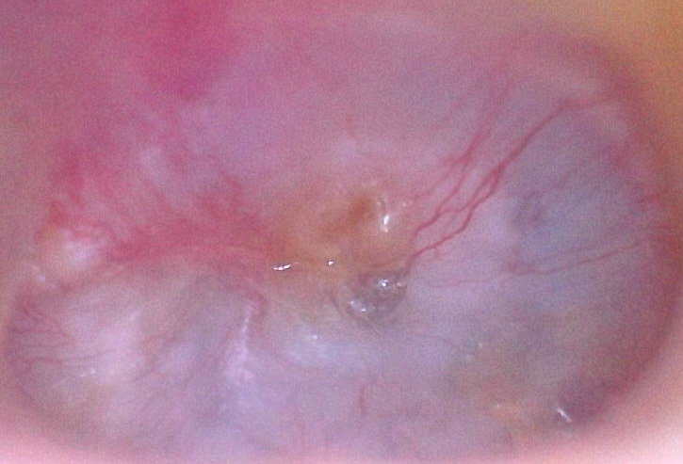
June 7th
3 days later and it’s
still closed.

Slide 42
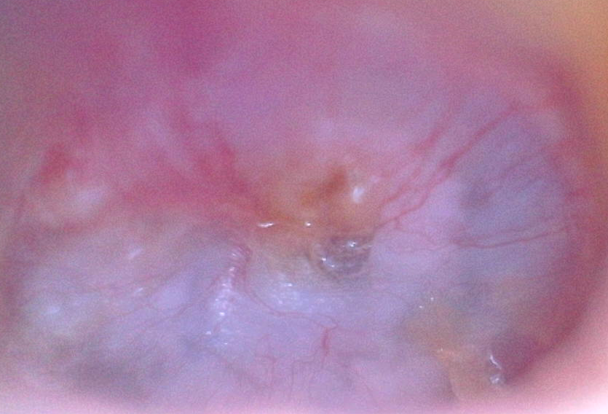
June 8th
4 days later and it’s
still closed.

Slide 43
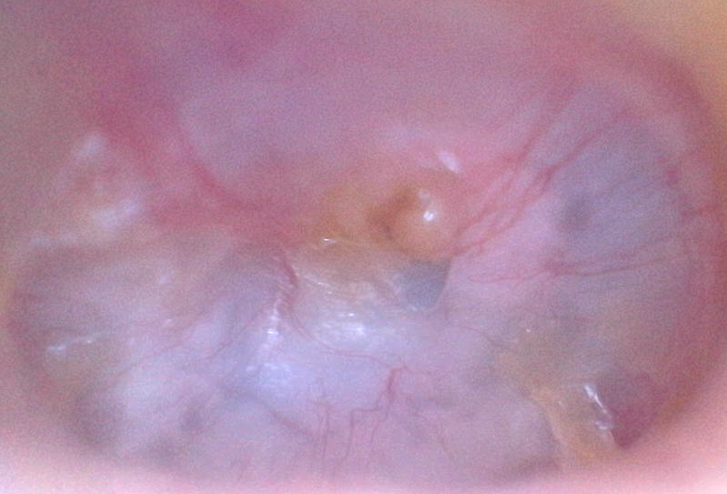
June 9th
5 days later and it’s
still closed.

Slide 44
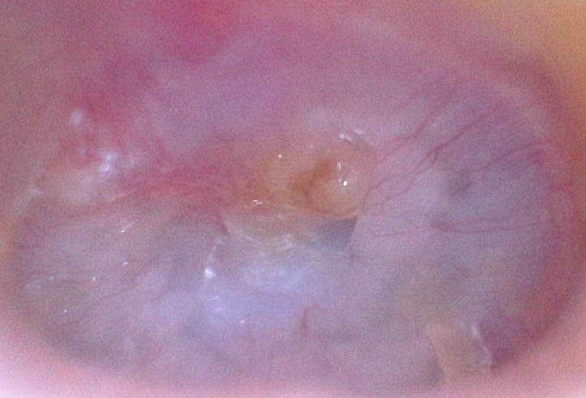
June 10th
6 days later and it’s
still closed.

Slide 45
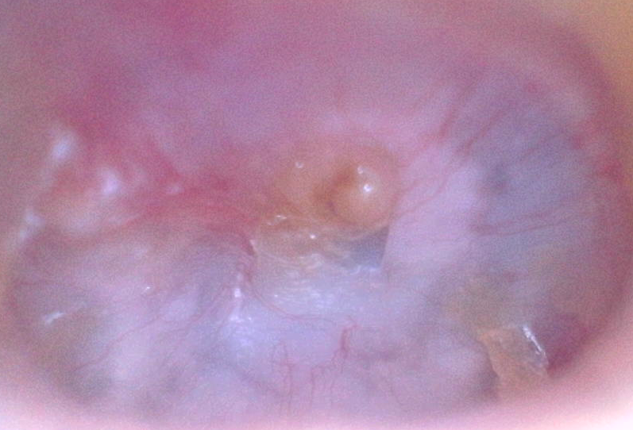
June 11th
7 days later and it’s
still closed.

Slide 46
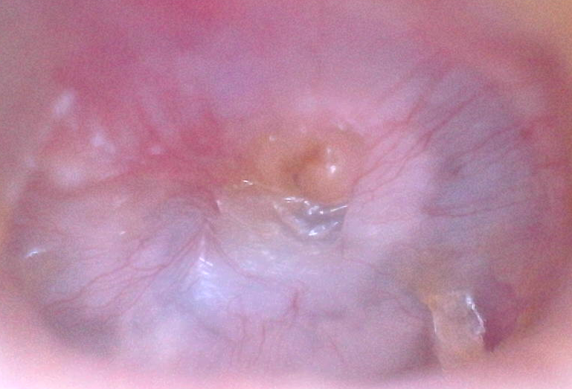
June 12th
8 days later and it’s
still closed.

Slide 47
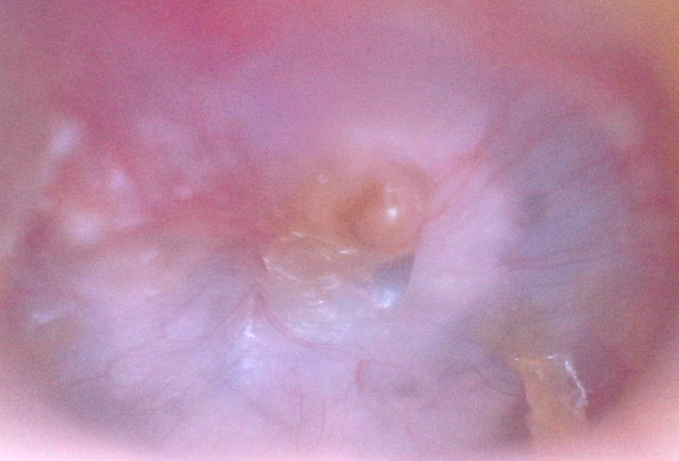
June 13th
9 days later and it’s
still closed.
But my hearing has not
continued to improve!

Slide 48
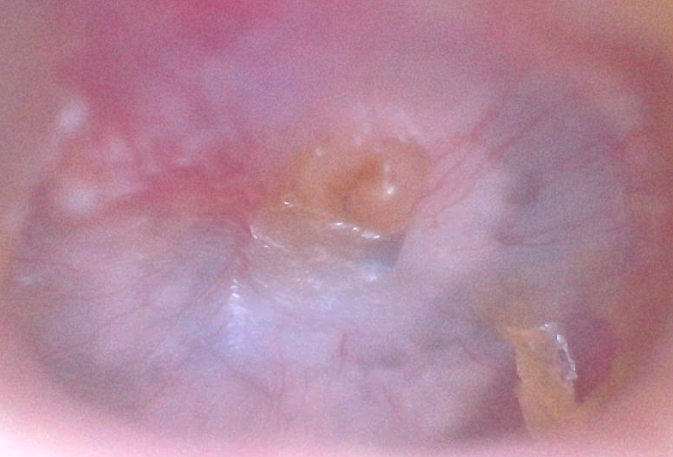
June 14th
10 days later and it’s
still closed.
Tomorrow I’m scheduled
for my first CI evaluation
appointment.

